Slide 1
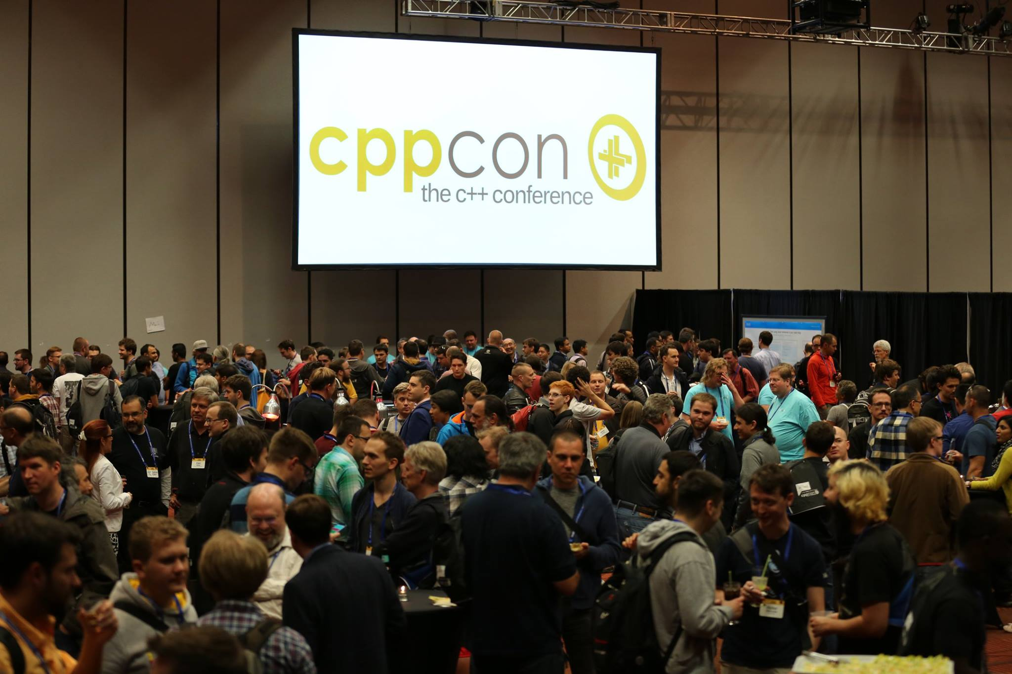

Slide 2

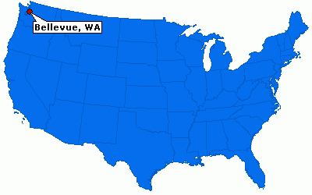
About CppCon
Created by isocpp.org in 2014
Bellevue, Washington
Every September
1100+ attendees
50+ speakers

Slide 3
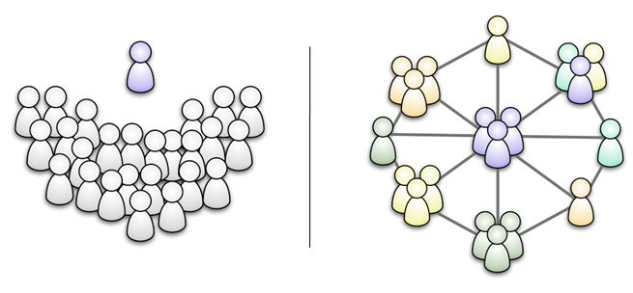
Conferences motivations
Meeting other C++ people
Sharing
Ideas
Frameworks
Knowledge
Educating people

Slide 4
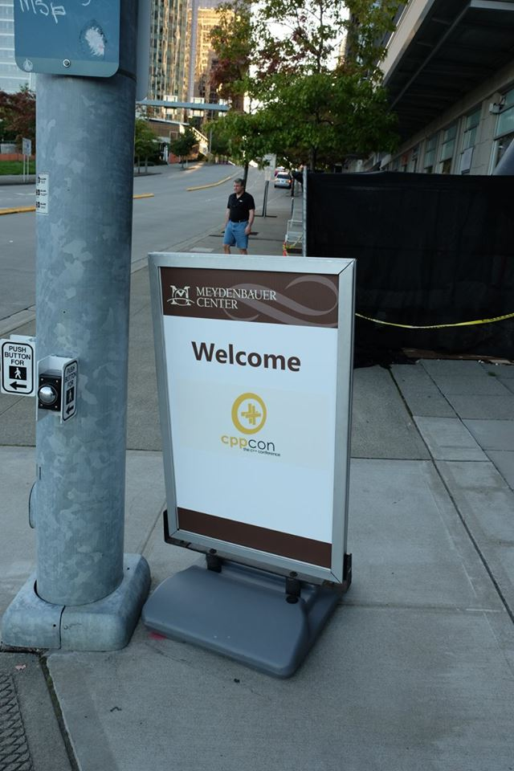
Program
[Pre|Post]-conference classes (2 days)
Concurrent Thinking in C++
Modern C++ Template Programming
Moving to C++17
C++ Best Practices
5 days event
Keynote (once a day)
Lectures
Lightning talks
Evenings events

Slide 5
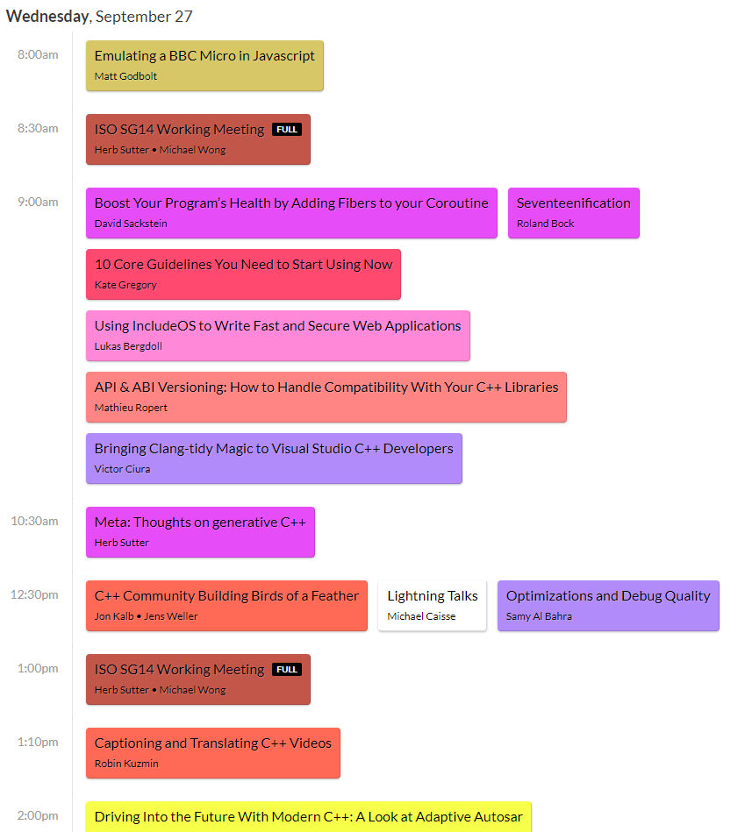

Slide 6
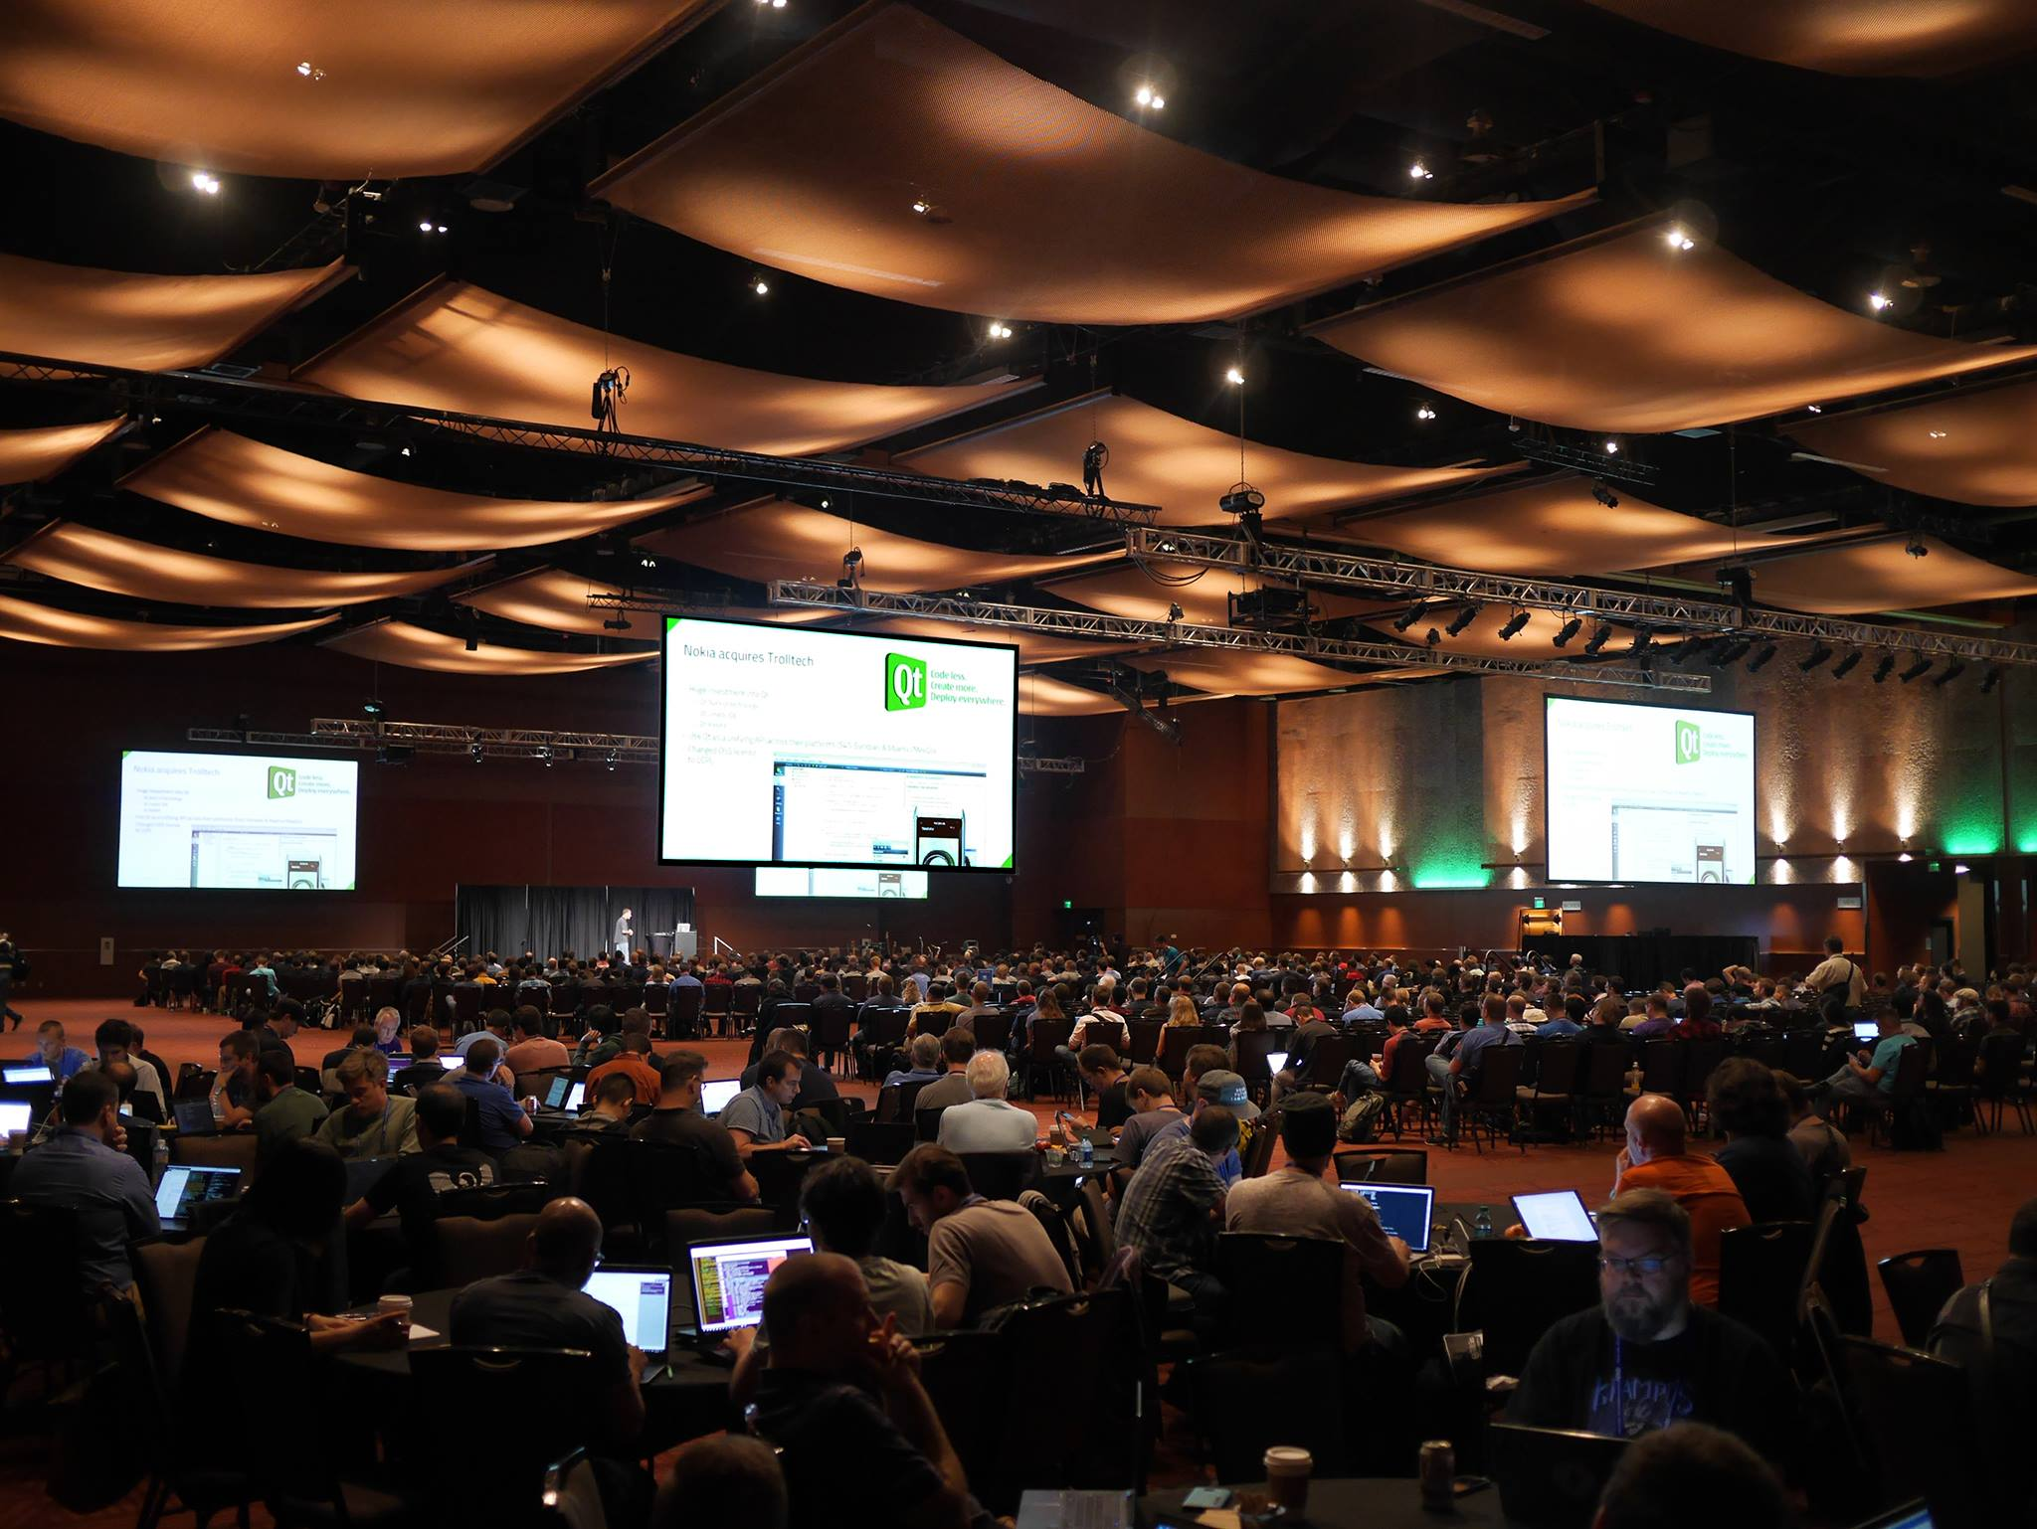
?cc=us

Slide 7
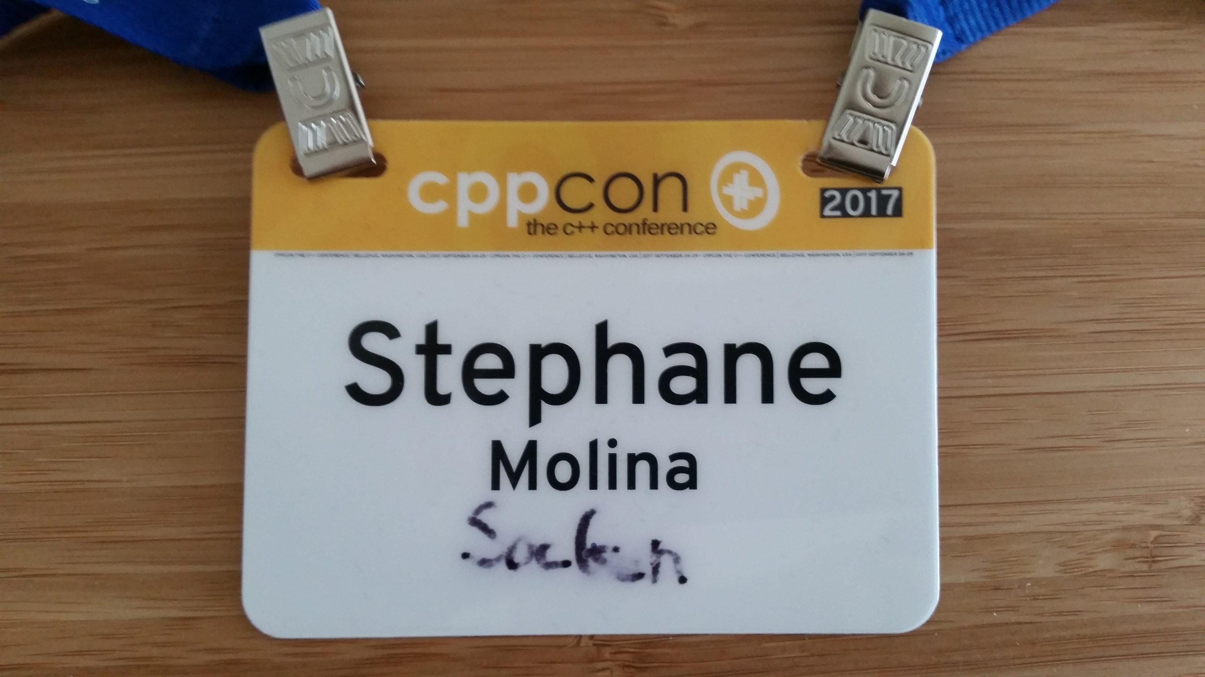

Slide 8
About this talk
Focus good practices C++17 and Keynotes
Another presentation on memory management and Allocators

Slide 9
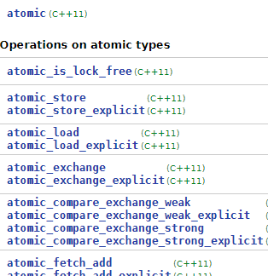
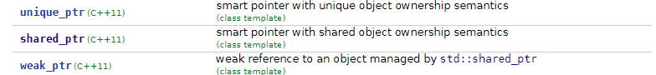
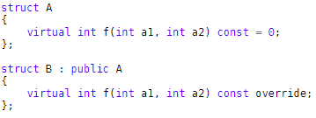
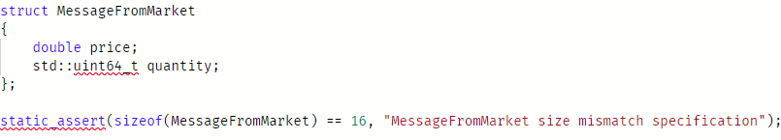
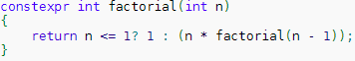
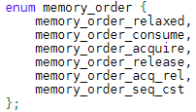
State of C++11
C++11 (Major upgrade)
Initializer list
Lambda
constexpr
Improvement of the containers
unordered_map, map
Small string optimization
O(1) size of list
Move semantics
Copy Elision
Ranged-based
Variadic templates
Explicit override, final, default, delete
Strong enum class
Static assertion
Smart pointer
Threading models and facilities (Threads, mutex, future, condition variable, promise, …)
Atomics
Stateful allocators
Many more (Tuples, auto, …)

Slide 10
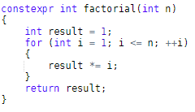
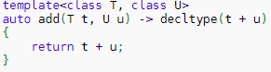
State of C++14
C++14 (Minor upgrade)
Function return type deduction
Relaxed constexpr restrictions
Generic lambdas
Small library features
std::shared_lock
std::make_unique
std::exchange
cbegin, cend, crbegin, crend

Slide 11
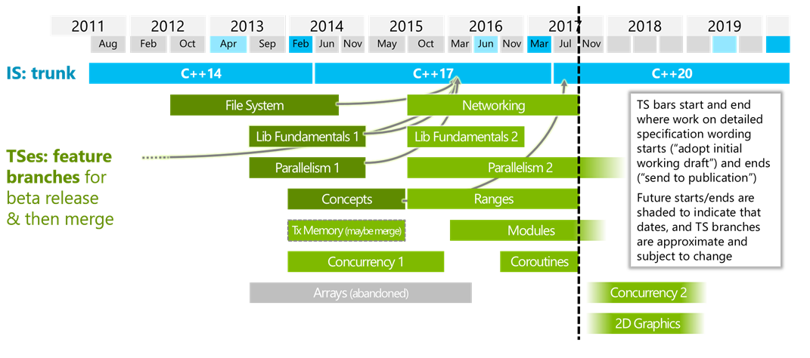
State of C++17

Slide 12
State of C++17
C++17 (Minor upgrade, but with many nice features)
Language
If constexpr
Structured binding
Initializer in if
New standard attributes ([[nodiscard]], [[fallthrough]], [[maybe_unused]])
Fold expressions for templates
Template deduction of constructors
Non type template argument with auto
Library
std::string_view, std::optional, std::any, std::variant, std::byte
std::size, std::empty, std::data
File system based on boost
Removal of deprecated features (e.g. auto_ptr)
polymorphic_allocator

Slide 13


State of C++17
Can I use XYZ feature?
Monitor the C++ Support of your compiler
Clang
GCC
Constantly update your compiler to the latest release
Clang Releases (5.0)
GCC Releases (7.2)
No cost
Benefit from latest optimization, error, warnings

Slide 14
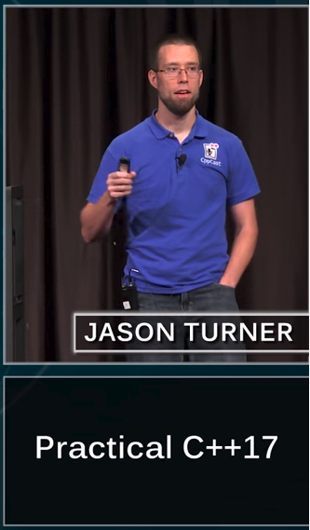
Practical C++17
Jason Turner
Active in the C++ community
CppCast
Weekly video
Part of trainer group
Creator of ChaiScript
Scripting for C++

Slide 15
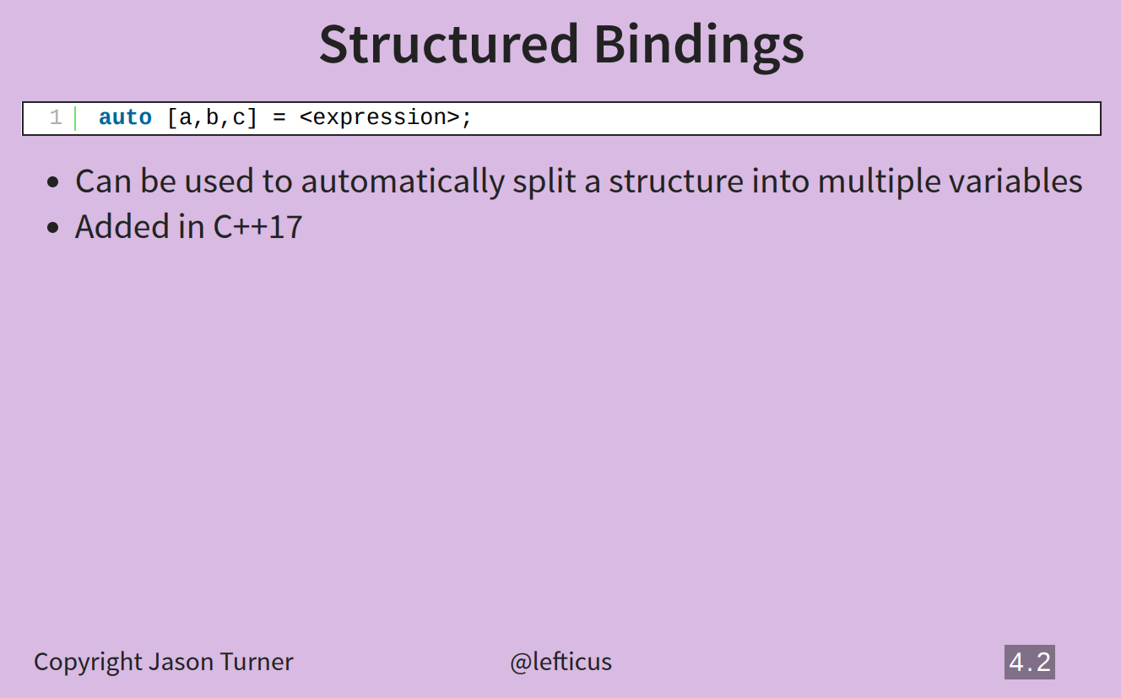
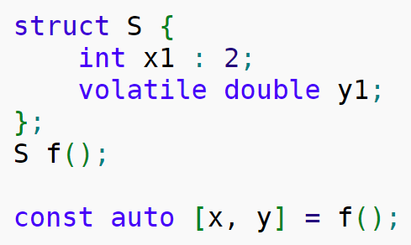

Slide 16
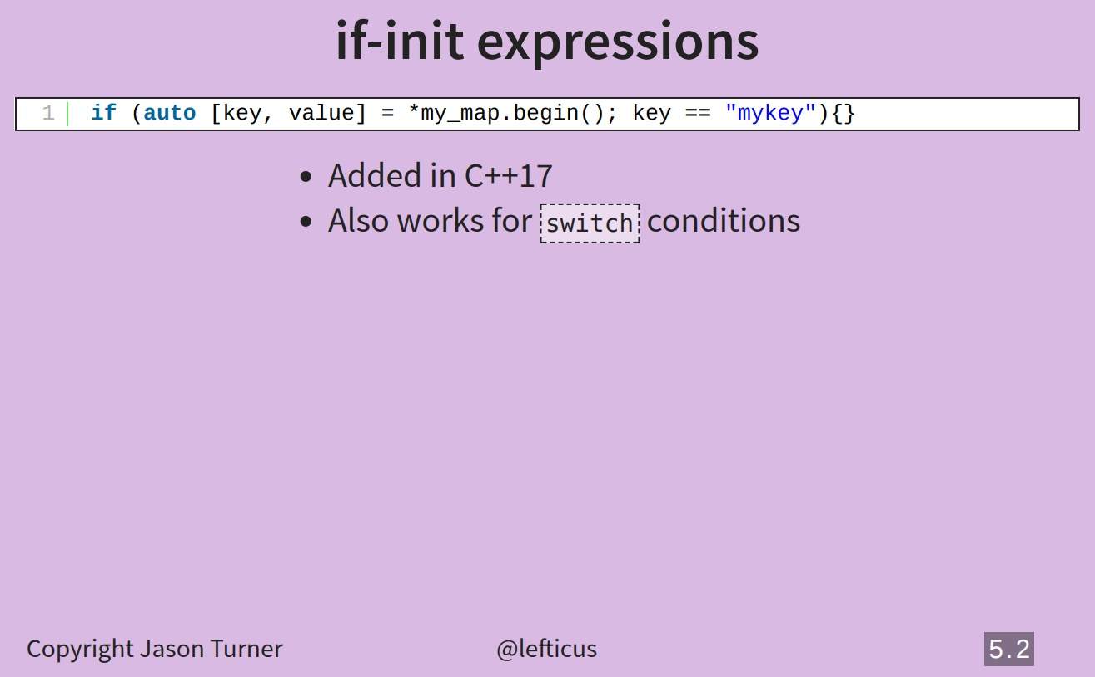

Slide 17
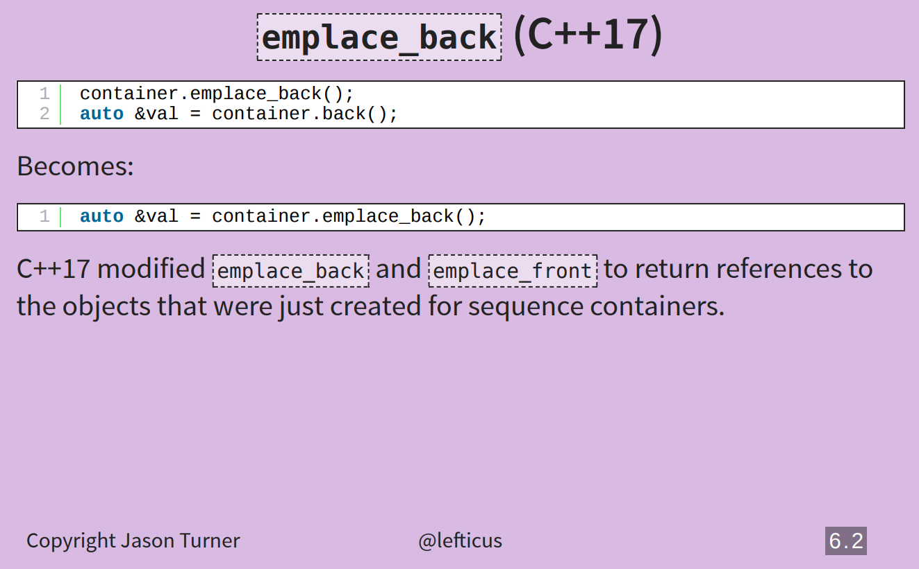

Slide 18
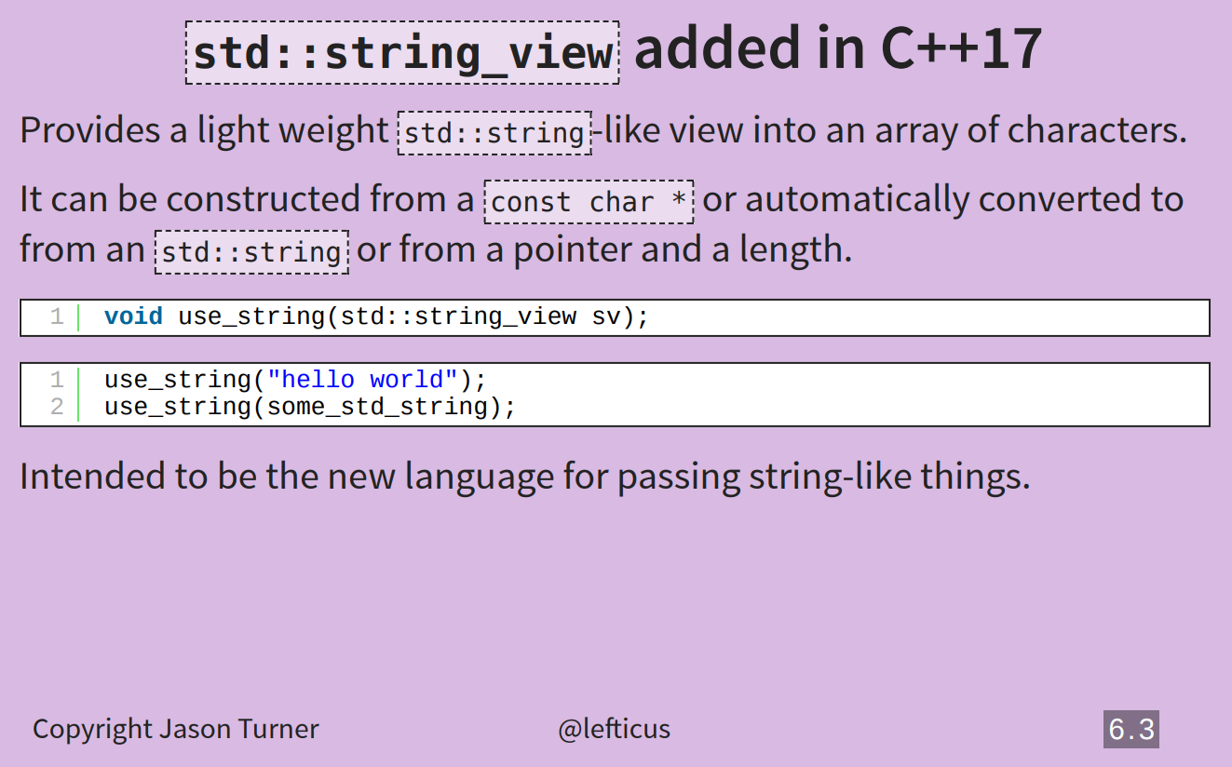

Slide 19
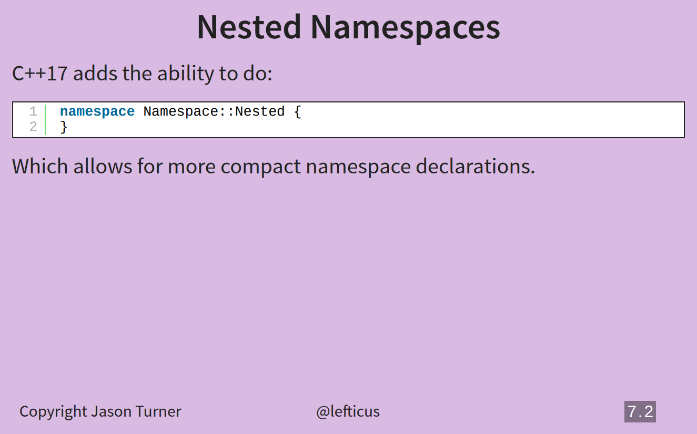
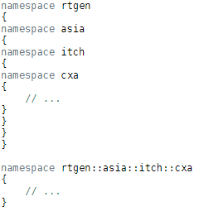

Slide 20
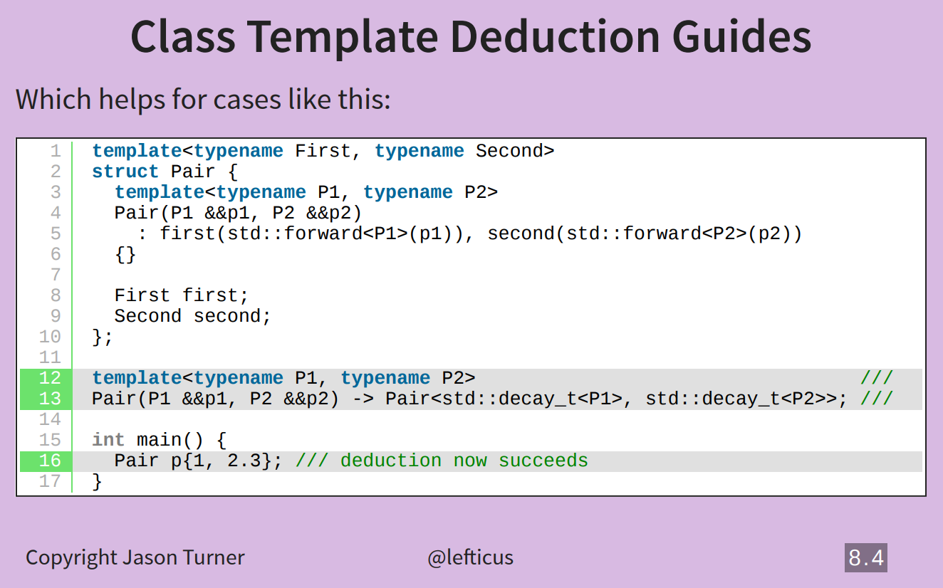

Slide 21
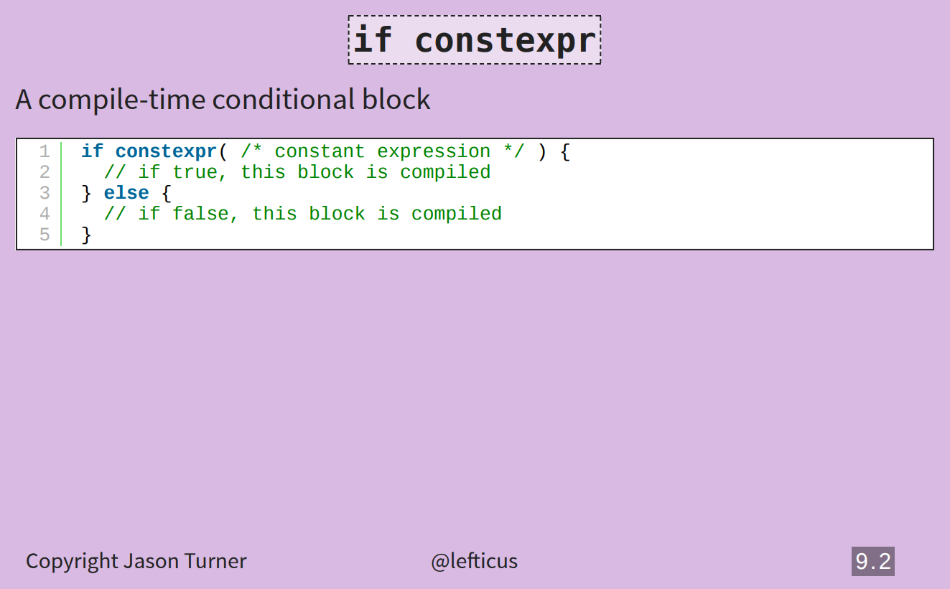
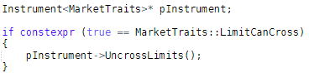

Slide 22
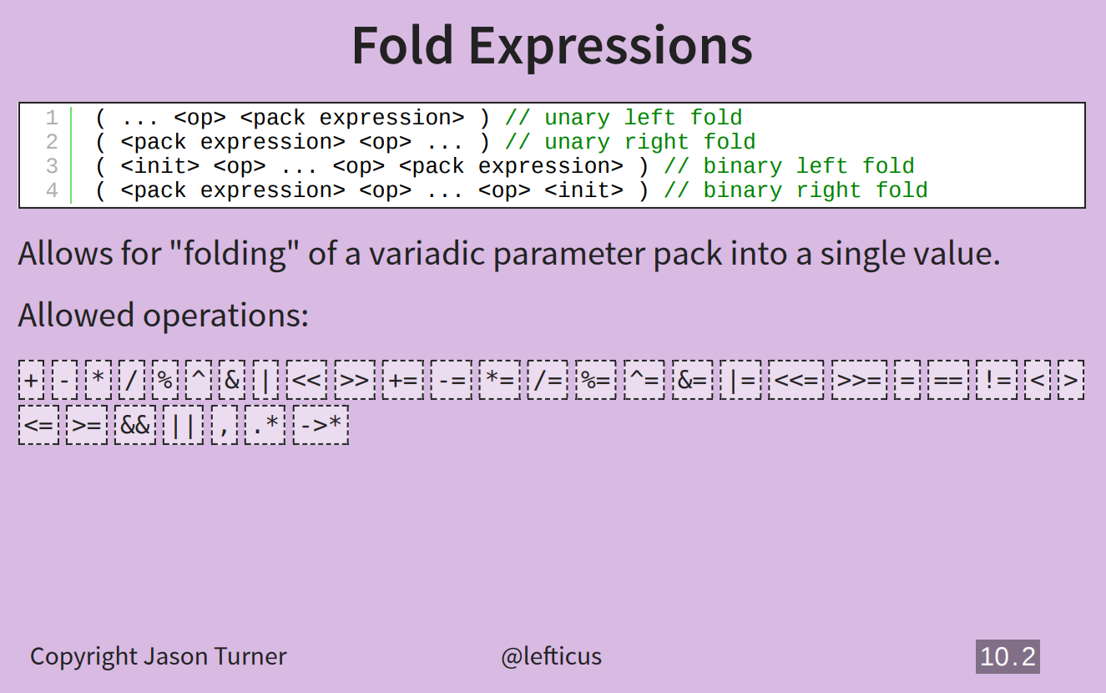
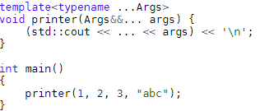

Slide 23
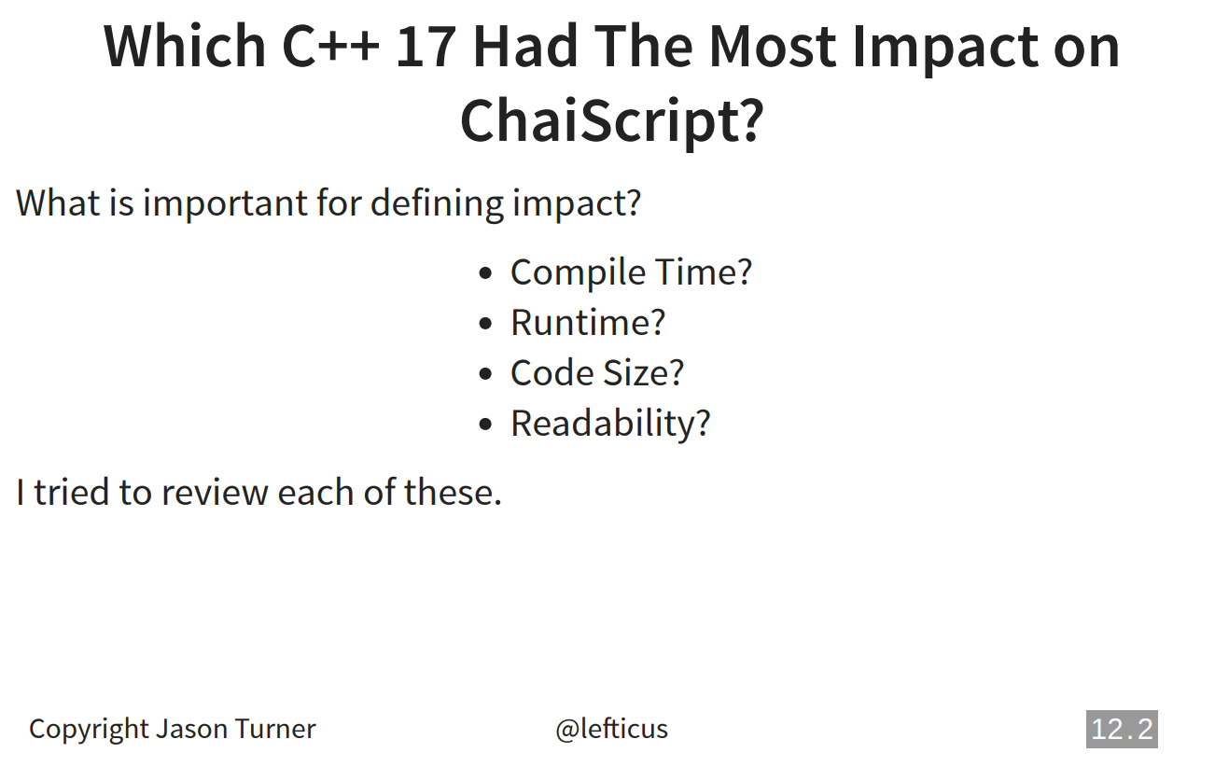

Slide 24
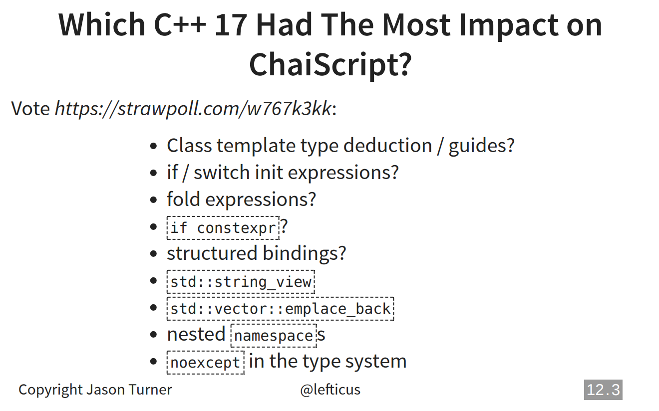

Slide 25
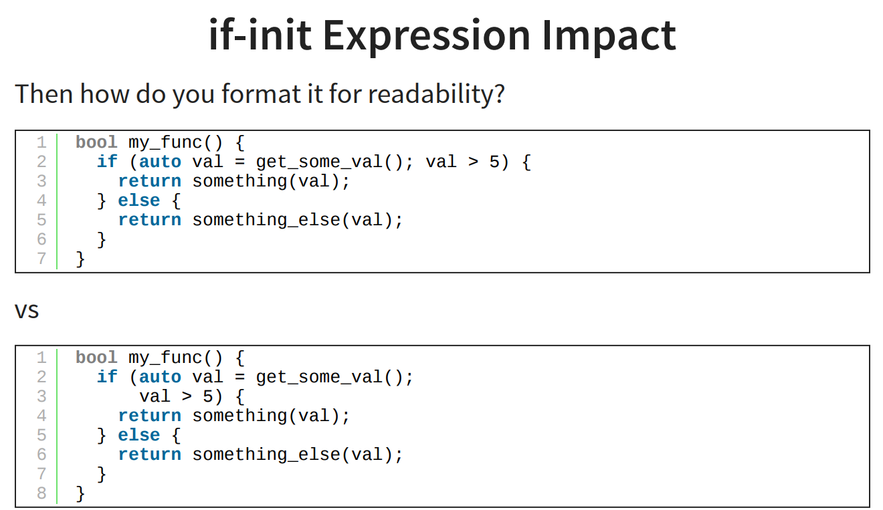

Slide 26
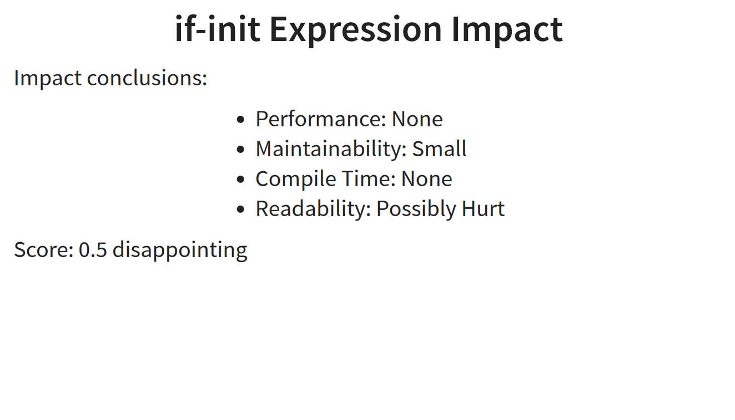
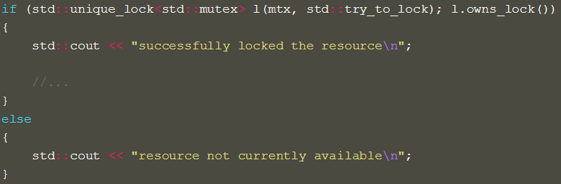

Slide 27
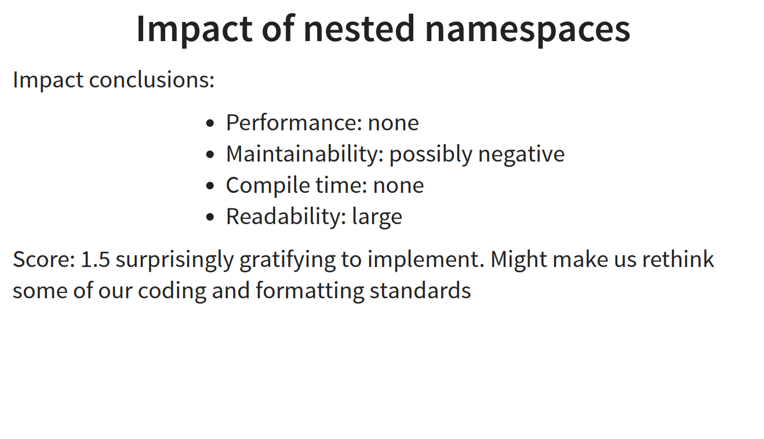

Slide 28
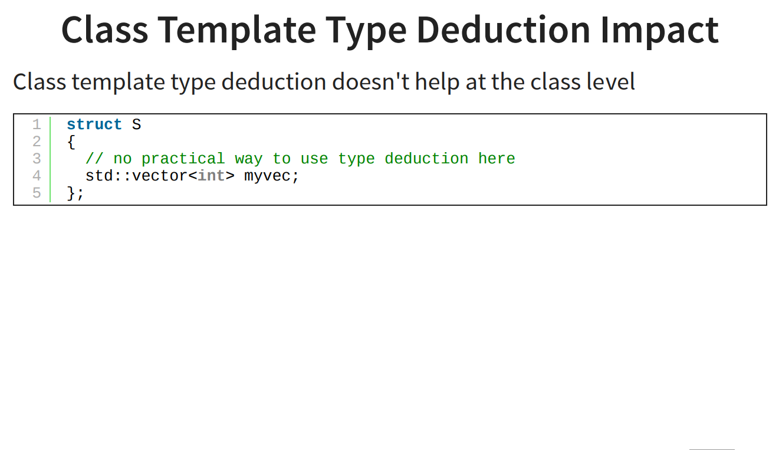

Slide 29
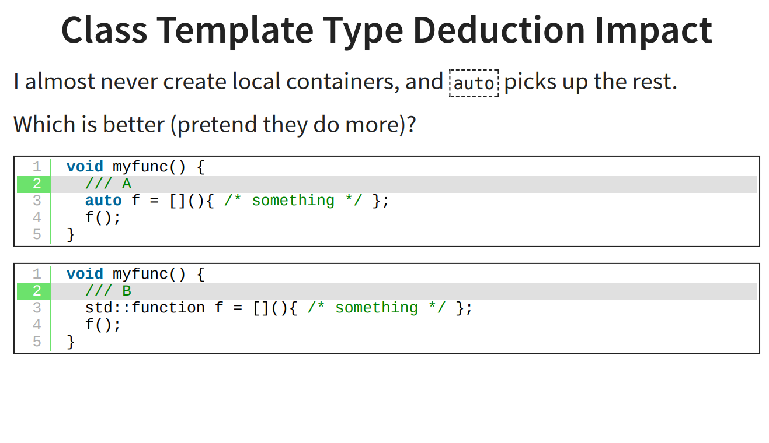

Slide 30
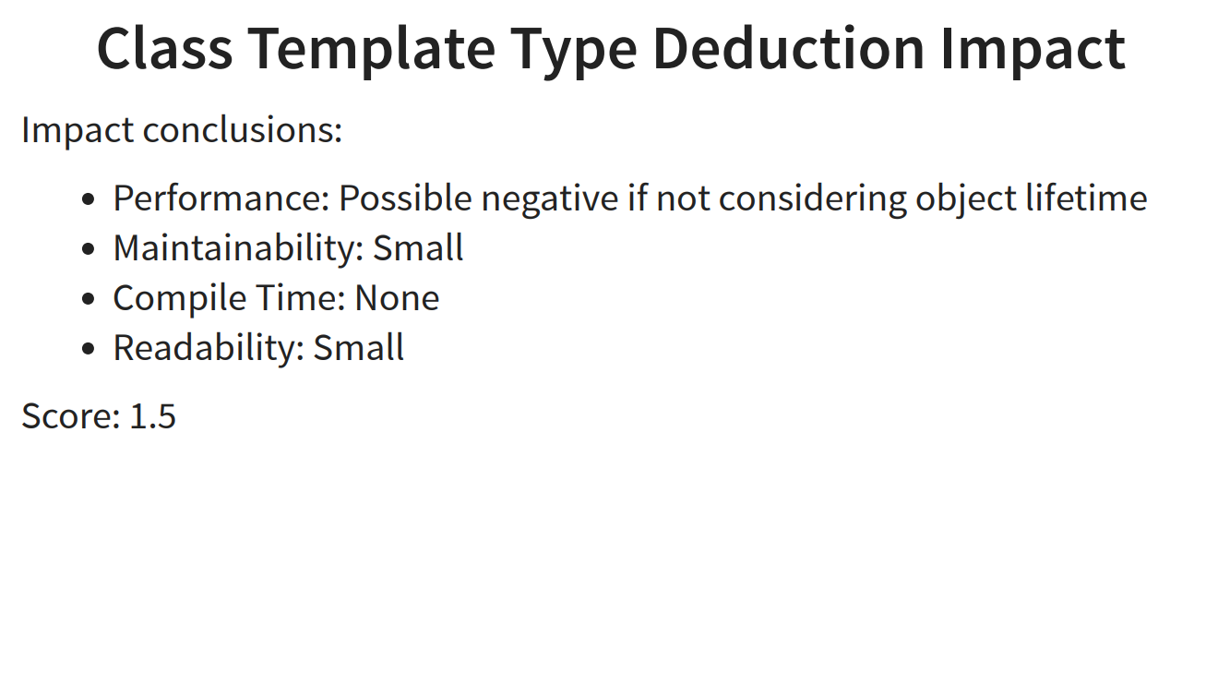

Slide 31
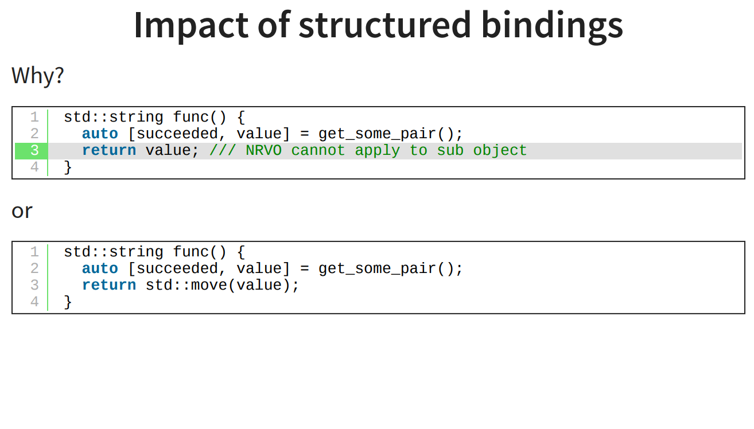
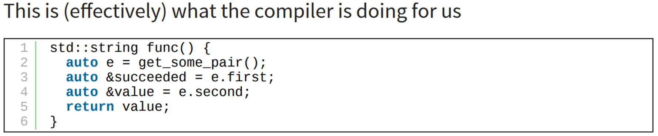
Suppose get_some_pair return std::pair<int, std::string>

Slide 33
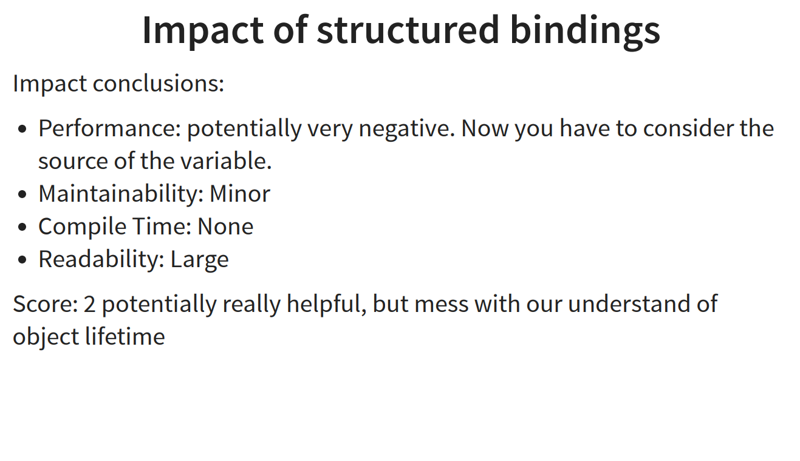

Slide 34
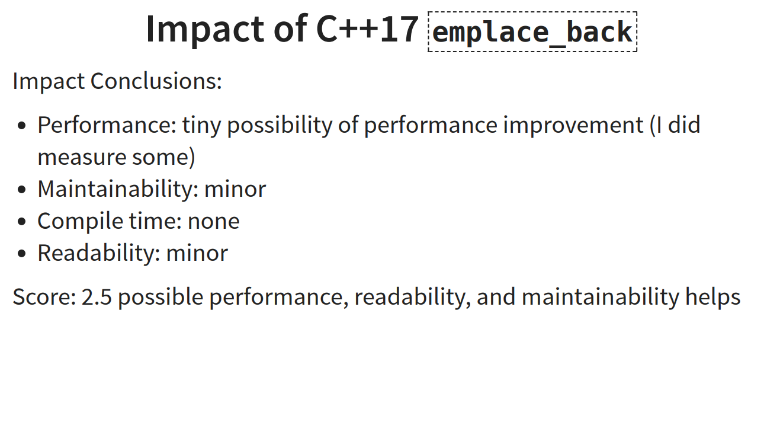

Slide 35
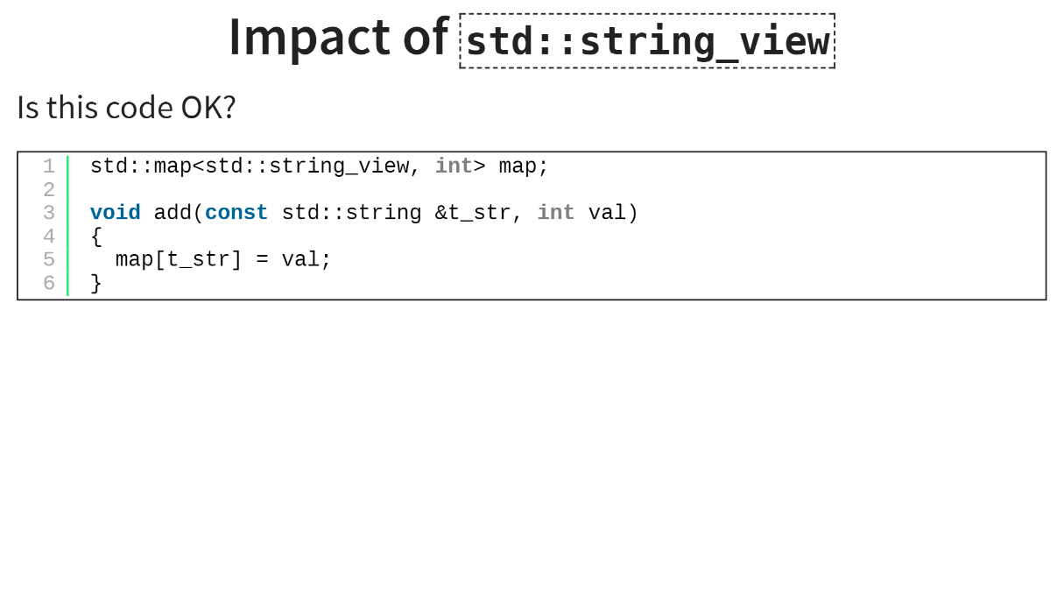

Slide 36
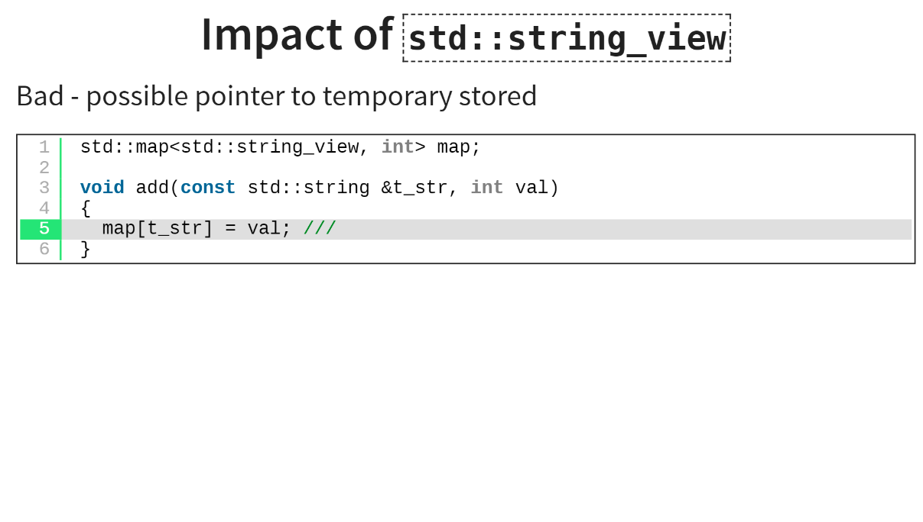

Slide 37
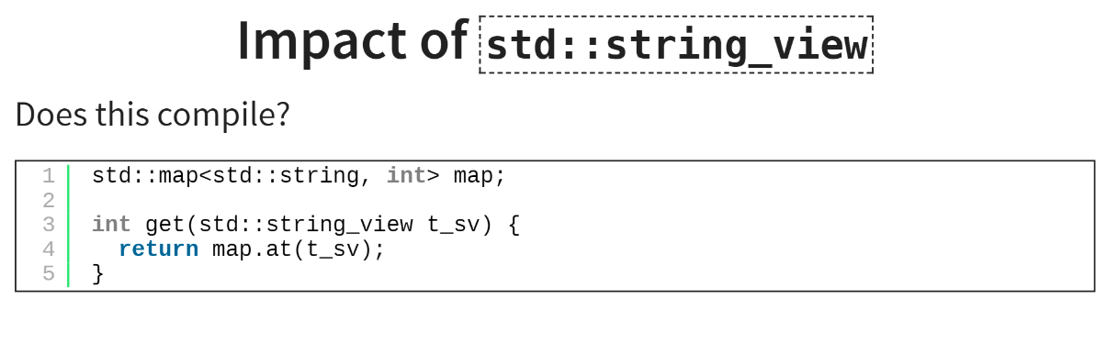

Slide 38
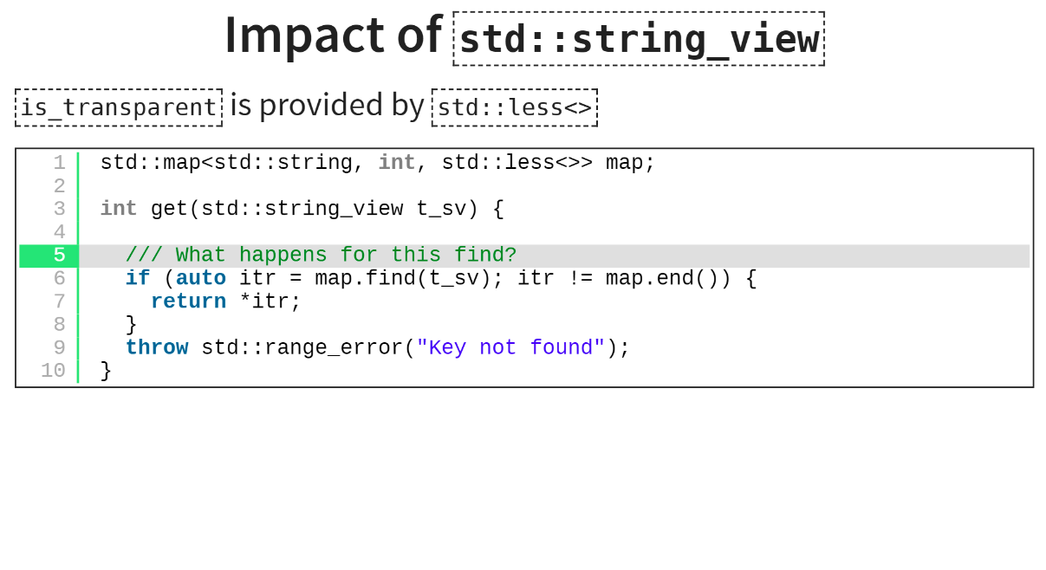


Slide 39
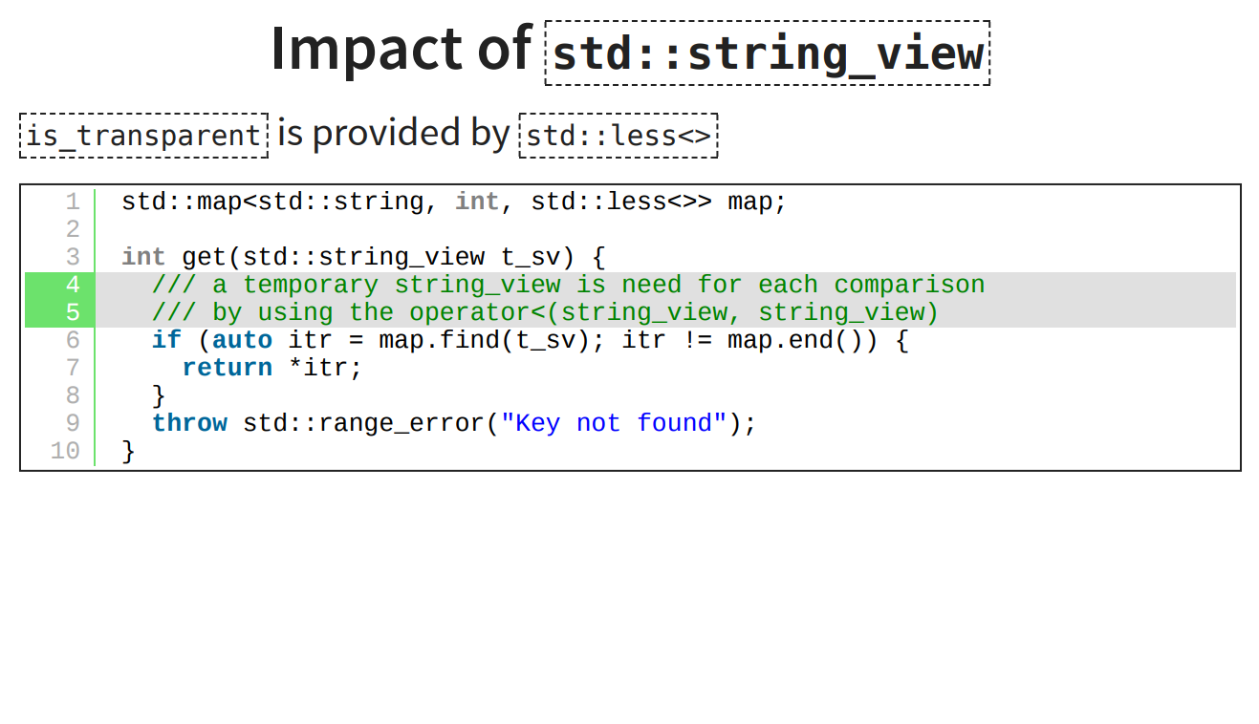

Slide 40
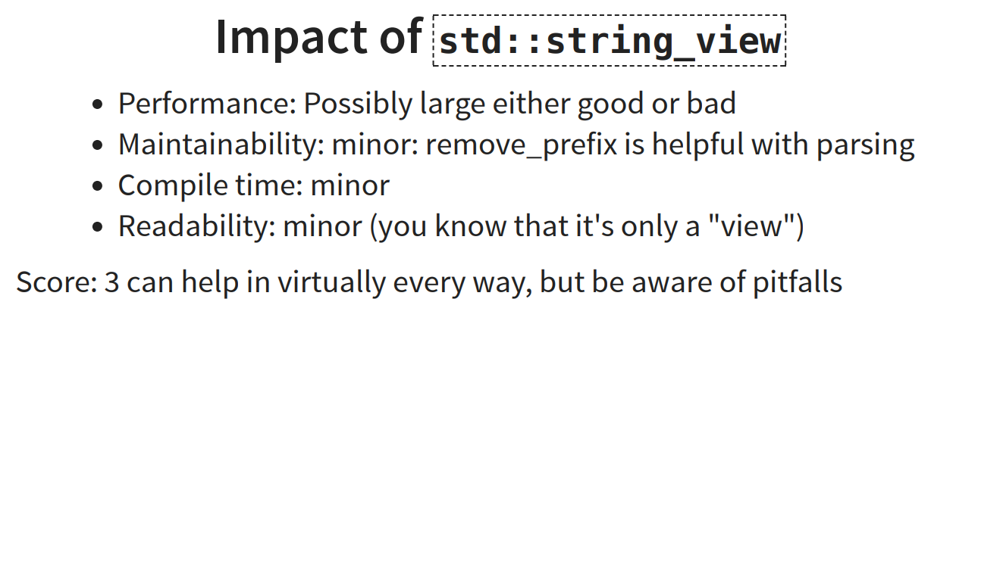

Slide 41
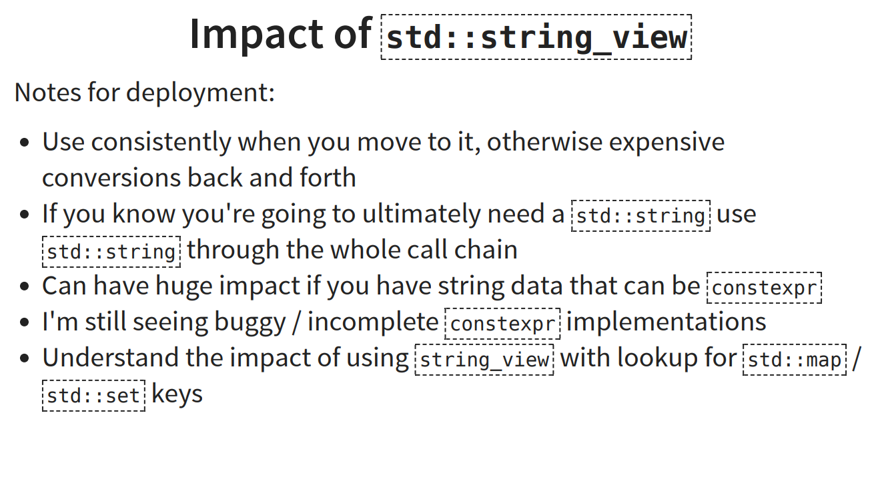

Slide 42
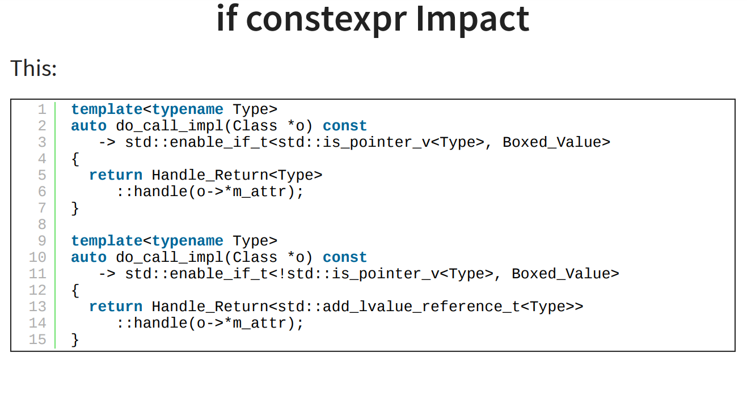

Slide 43


Slide 44


Slide 45


Slide 46


Slide 47


Slide 48


Slide 49


SCM Challenge
https://scmchallenge.com/

Slide 50


Slide 51


Slide 52


Slide 53


Slide 54


Slide 55


Slide 56


Slide 57


Slide 58


Slide 59


Slide 60


Slide 61


Slide 62


Slide 63


Slide 64


Slide 65


Slide 66


Slide 67


Intel Xeon E5 processor

Slide 68


Slide 69


Slide 70


Slide 71


Slide 72


Slide 73


Slide 74
Learning and Teaching Modern C++
CppCore Guidelines
Need More tools
C++ lack of an official packaging system
Conan package but not enough
First Proposal on the subject but early stage
Clang tidy to ensure the Guidelines are respected
More static analysis will be needed
Metaclass
Concepts
Modules

Slide 75


Slide 76
C++ as a Live at Head Language
Philosophy
Semantic Versioning
When delivering a new library version, need to provide a tool to update the client automatically
Always work on the head, never delay an update
Abseil
New open source library
Designed to augment the C++ standard library collection
Massively used within google
New flat hash map to come Q1 2018
Tips of the week

Slide 77


Slide 78


Slide 79


Slide 80




What has my compiler done for me lately?
Highly recommended Talk
Discuss about the idea behind compiler explorer
Live coding
Great tutorial to be able to analyze assembly code

Slide 81

Metaclass
Highly recommended Talk
Proposal introduced to the committee in July
Not supported yet by any compiler
Unlikely to be ready for C++20
New major feature of C++

Slide 82



Slide 83


Slide 84


Slide 85


Slide 86


Slide 87


Slide 88


Slide 89


Slide 90


Slide 91


Slide 92


Slide 93


Slide 94


Slide 95


Slide 96


Slide 97










Tools
Uftrace
Profiling
Clang Format
Style
Clang Tidy
Large scal refactoring
Google sanitizers
Dynamic analysis
Code reside in LLVM

Slide 98


Slide 99
Top 4 recommended talks
Make Classes Great Again (Vinni Falco)
Enthusiastic talk about how to design an efficient modular API
One of the best support to understand based-design policy (massively used in Asia Feed)
Meta: Thoughts on generative C++ (Herb Sutter)
What Has My Compiler Done for Me Lately? (Matt Godbolt)
Local Memory Allocators (John Lakos)

Slide 100

Another Session for the Allocators
Complex due to the legacy of C++03
C++17 polymorphic allocator make the allocator easily usable
6 Talks on that topic
Key concept for performance

Slide 101

Questions?

